Slide 1
DEADLOCKS Deadlock Avoidance Deadlock Prevention Other Issues

Slide 2
Review
Deadlock
A set of blocked processes each holding a resource and waiting to acquire a resource held by another process in the set, thus they will remain so forever (deadlocks)
Resources
Refer the objects as hardware devices, data records, files, etc .. that must be granted, acquired, used and released
02 types: Preemptable, Nonpreemptable
4 conditions
Mutual exclusion condition
Hold and wait condition
No preemption condition
Circular wait condition
Four conditions for resource deadlocks can be modeled using directed graphs that help carrying out the requests and releases step by step, and after every step check the graph to see if it contains any cycles to check deadlock or not

Slide 3
Review
Deadlock
Strategies
The Ostrich Algorithms
Just ignore the problem
The device driver decide blocking or returning an error code
Detection
Deadlock Detection with One Resource of Each Type: using algorithm to traverse the directed graph using Deadlock modeling
Deadlock Detection with Multiple Resource of Each Type: using existing resource vector (E), available resource vector (A), current allocation matrix (C), request matrix (R)
Recovery
Recovery through Preemption: take a resource away from a process, have another process use it, and then give it back without the process noticing it is highly dependent on the nature of the resource
Recovery through Rollback: checkpoint is used to store the process state that is used to reset when the deadlock occurs
Recovery through Killing Processes: break the cycle with internal and external resources

Slide 4
Objectives …
Deadlock avoidance
Resource Trajectories
Safe and Unsafe States
The Banker’s Algorithms for a Single Resource
The Banker’s Algorithms for a Multiple Resource
Deadlock Prevention
Attacking the Mutual Exclusion Condition
Attacking the Hole and Wait Condition
Attacking the No Preemption Condition
Attacking the Circular Wait Condition
Other Issues
Two-Phase Locking
Communication Deadlocks
Live Lock
Starvation

Slide 5
Deadlock Avoidance Context
In most system, resources are requested one at a time (does not ask resources all at one)
The system must be able to decide whether granting a resource is safe or not and only make the allocation when it is safe
Is there an algorithm that can always avoid deadlock by making the right choice all the time?
Yes, the deadlock can be avoided, but only if certain information is available in advance
→carefully resource allocation

Slide 6
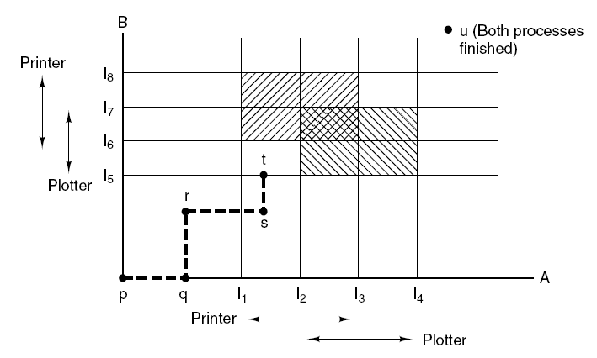
Deadlock Avoidance Resource Trajectories
Tanenbaum, Fig. 6-8.

Slide 7
Deadlock Avoidance Safe and Unsafe States
A state is said to be safe if there is some scheduling order in which every process can run to completion even if all of them suddenly request their maximum number of resources immediately
A system is in a safe state only if there exists a safe sequence
Let n process in order P₁ … P_{n}. Each process is a safe sequence for current allocation state if
For each P_{i}, the resources that P_{i} still request can be satisfied by the currently available resources plus the resources held by all the P_{j}, with j<i
If the resource that P_{i} needs are not immediately available, the P_{i} can wait until all P_{j} have finished
When P_{i} terminates, the P_{i+1} can obtain its needed resource
→ The system state is unsafe when the above condition does not exist

Slide 8
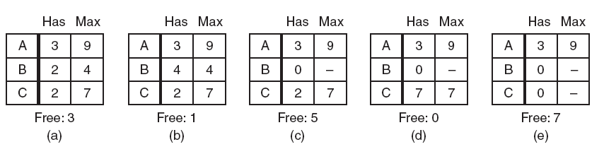
Deadlock Avoidance Safe and Unsafe States
Tanenbaum, Fig. 6-9.
Safe
3 processes
1 resource with
10 instance

Slide 9
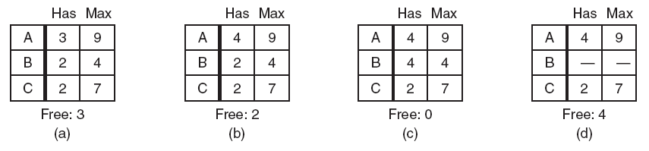
Deadlock Avoidance Safe and Unsafe States
UnSafe
3 processes
1 resource with
10 instance
Tanenbaum, Fig. 6-9.

Slide 10
Deadlock Avoidance Safe and Unsafe States
Basic fact
If a system is in safe state → no deadlocks
If a system is in unsafe state → possibility of deadlock
To avoidance deadlocks → ensure that a system will never enter an unsafe state

Slide 11
Deadlock Avoidance The Banker’s Algorithm for a Single Resource
Is used to avoid and detect deadlock
Ideas
A small-town banker might deal with a group of customers to whom he has granted lines of credit (to making loan requests time to time)
Algorithm
Considers each request as it occurs, and sees if granting it leads to a safe state
If it does, the request is granted; otherwise, it is postponed until later
To see if a state is safe, the banker checks to see if he has enough resources to satisfy some customer
If so, those loans are assumed to be repaid, and customer now closest to the limit is checked
If all loans can eventually be repaid, the state is safe and the initial request can be requested

Slide 12
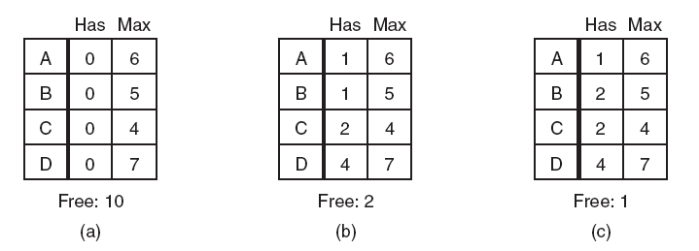
Deadlock Avoidance The Banker’s Algorithm for a Single Resource
Safe Safe Unsafe
Tanenbaum, Fig. 6-11.

Slide 13
Deadlock Avoidance The Banker’s Algorithm for a Multiple Resource
Algorithm for checking to see if a state is safe:
Look for row, R, whose unmet resource needs all ≤ A. If no such row exists, system will eventually deadlock since no process can run to completion
Assume process of row chosen requests all resources it needs and finishes.
Mark process as terminated, add all its resources to the A vector.
Repeat steps 1 and 2 until either all processes marked terminated (initial state was safe) or no process left whose resource needs can be met (there is a deadlock).
Disadvantages:
It is essentially useless because process rarely know in advance what their maximum resource needs will be
In addition, the number of processes is not fixed, but dynamically varying as new users log in and out
Furthermore, resources that were thought to be available can suddenly vanish

Slide 14
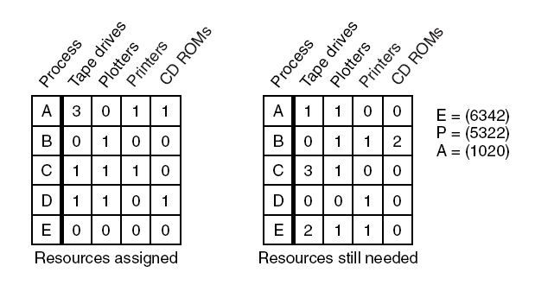
Deadlock Avoidance The Banker’s Algorithm for a Multiple Resource
Progress: D, E, A, B, C
Tanenbaum, Fig. 6-11.

Slide 15
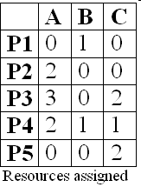
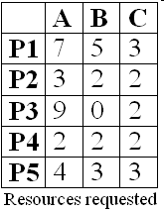

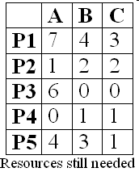
Deadlock Avoidance The Banker’s Algorithm for a Multiple Resource
No Process deadlock

Slide 16
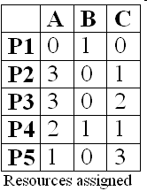

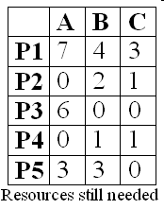
Deadlock Avoidance The Banker’s Algorithm for a Multiple Resource
All Process are deadlocked

Slide 17
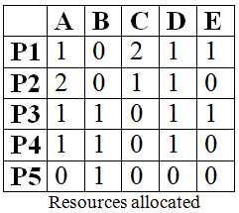

Deadlock Avoidance The Banker’s Algorithm for a Multiple Resource
 | A | B | C | D | E
P1 | 1 | 1 | 2 | 1 | 2
P2 | 2 | 2 | 2 | 1 | 0
P3 | 2 | 1 | 3 | 1 | 1
P4 | 1 | 1 | 1 | 2 | 1
P5 | 0 | 1 | 1 | 1 | 1
Maximum Resources requested
What is the smallest value of x for which this is a safe state? And which progress of processes?

Slide 18
Deadlock Avoidance The Banker’s Algorithm for a Multiple Resource
 | A | B | C | D | E
P1 | 0 | 1 | 0 | 0 | 1
P2 | 0 | 2 | 1 | 0 | 0
P3 | 1 | 0 | 3 | 0 | 0
P4 | 0 | 0 | 1 | 1 | 1
P5 | 0 | 0 | 1 | 1 | 1
Resources still needed
- The smallest value of x is 1
- The progress is P4, P5, P1, P2, P3

Slide 19
Deadlock Avoidance The Banker’s Algorithm for a Multiple Resource
A system has five processes and three allocated resources. The current allocation and request needs are as follows:
Process | Allocated | Currently Request | Available
A | 010 | 000 | 100
B | 200 | 202
C | 303 | 001
D | 211 | 100
E | 022 | 002
- What do the processes progress in sequence?
- The progress is A, D, C, E, B

Slide 20
Deadlock Prevention Attacking the Mutual Exclusion Condition
Avoiding assigning a resource when that is not absolutely necessary, and
Try to make sure that as few processes as possible may actually claim the resource
Ex
spooling and daemon in printer (user software layer)

Slide 21
Deadlock Prevention Attacking the Hold and Wait Condition
Must guarantee that whenever a process requests a resource, it does not hold any other resources, or
Prevent process that holds resource from waiting for more resources
→ all process to request all their resources before starting execution
If everything is available, the process will be allocated whatever it needs and can run to completion
If one ore more resources are busy, nothing will be allocated and the process would just wait
Problems
Many process do not know how many resources they will need until they have started running
Resources will not be used optimally
Disadvantages: put a burden on the programmer and waste resource
Advantages: prevent deadlocks and can be applied to batch system
Others: require a process requesting a resource to first temporarily release all the resource it currently holds, then it tries to get everything it needs all at one

Slide 22
Deadlock Prevention Attacking the No Preemption Condition
If a process that is holding some resources requests another resource that cannot be immediately allocated to it, then all resources currently being held are released
Preempted resources are added to the list of resources for which the process is waiting
Process will be restarted only when it can regain its old resources, as well as the new ones that it is requesting
Some recourse can be virtualized to avoid the first condition such as spooling and daemon

Slide 23
Deadlock Prevention Attacking the Circular Wait Condition
First approach
A process is entitled only to a single resource at the moment.
If it needs a second one, it must release the first one
→if a process needs to copy a huge file from a tape to a printer, this restriction is unacceptable
Second approach
Provide a global numbering of the resources
Process can request resources whenever they want to, but all requests must be made in numerical order
→ the resource allocation graph can never have cycles but the numerically ordering the resources may be impossible to find an ordering that satisfies every ones

Slide 24
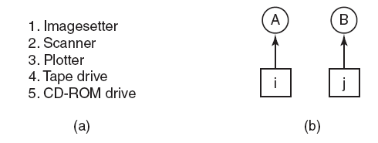
Deadlock Prevention Attacking the Circular Wait Condition
Tanenbaum, Fig. 6-13.
Deadlock occurs only if A request j and B request i (i ≠ j)
If i>j, the A is not allowed to request j because that is lower than what it already has
If i<j, the B is not allowed to request i because that is lower than what is already has
→ deadlock is impossible

Slide 25
Deadlock Prevention Attacking the Circular Wait Condition
With more than two processes
At every instant, one of the assigned resources will be highest
The process holding that resource will never ask for a resource already assigned
It will either finish, or at worst, request even higher numbered resources, all of which are available
Eventually, it will finish and free resources. At this point, some other process will hold the highest resource and can also finish
→all processes finish, so no deadlock occurs
A minor variation of the algorithm
Drop the requirement that resource be acquired in strictly increasing sequence and merely insist that no process request a resource lower than what it is already holding

Slide 26
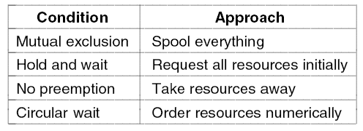
Deadlock Prevention Summarized
Tanenbaum, Fig. 6-14.

Slide 27
Other Issues Two-Phase Locking
Context
In many DB systems, an operation that occurs frequently is requesting locks on several records and then updating all the locked records
When multiple processes are running at the same time, there is a real danger of deadlock
Two-phase locking
First phase, the process tries to lock all records it needs, one at a time.
If it succeeds, it begins the second phase, performing its updates and releasing the locks (then starts the first phase all over)
→request all the resources needed in advance, or at least before irreversible is done
There is no release and restart of a locked record is encountered during the first phase → deadlock can occur
This strategy is not applicable in general for many applications (except DB systems)
To apply, the programmer has very carefully arranged things so that the program can be stopped at any point during the first phase and restart

Slide 28
Other Issues Communication Deadlocks
Deadlock can occur in communication system in which two or more process communicate by sending message
Problems
Process A sends a request message to process B, then blocks until B sends back reply the message
If the request message gets lost, both A and B are blocked
Communication deadlock
The set of processes is deadlock if each blocked waiting for an event only the other one can cause
Cannot be prevented by ordering the resource (since there are none) or avoided by careful scheduling (since there are no moments when a request could be postponed)
→deadlock is prevented using timeout (or handling alarm)

Slide 29
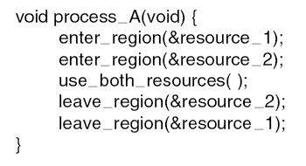
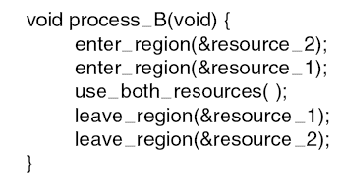
Other Issues LiveLock
Context
Mutual exclusion
Busy waiting
Definition
Each process acquires one resources, but it is not progressing because it uses up its CPU quantum over and over and over to checking to take/ enter the resource/ critical regions (in the other word, it is running)
→ Is the equivalent of deadlock but no process is blocked (and it is similar to starvations because the process must wait for a long time)
Tanenbaum, Fig. 6-16.

Slide 30
Other Issues LiveLock
Context
Mutual exclusion
Busy waiting
Definition
Each process acquires one resources, but it is not progressing because it uses up its CPU quantum over and over and over to checking to take/ enter the resource/ critical regions (in the other word, it is running)
→ Is the equivalent of deadlock but no process is blocked (and it is similar to starvations because the process must wait for a long time)
Tanenbaum, Fig. 6-16.

Slide 31
Other Issues LiveLock
Case studies
The process table slots are finite resource. When the table is full, the live lock occurs due to wait a random time and try again to enter the process table
Same as the i-node table slots to open files are finite resource
Solutions
Abolish all the finite resources and each items can claim 1/n of the total (fairness is not a good idea)
Most OS just ignore the problem on the assumption that most users would prefer an occasional livelock to rule restricting all users to one process, one open file, and one everything
→ Face with an unpleasant trade-off between convenience and correctness

Slide 32
Other Issues Starvation
Some policy is needed to make a decision about who gets which resource when
→ may lead to some processes never getting service even though they are not deadlocks
Ex
A dinner philosophers problems
To avoid starvation
The FCFS is used for resource allocation policy
Disadvantages: the process waiting the longest gets served next

Slide 33
Summary
Resources
Introduction To Deadlocks
The Ostrich Algorithm
Deadlock Detection & Recovery
Deadlock Avoidance
Deadlock Prevention
Other Issues
Q&A

Slide 34
Next Lecture
N/A
Good luck to you ☺

